Slide 1
GUI Exercise 3
Next Robotics

Slide 2
Text Fields and Event Handling
Note:
Event Driven :- the user can interact with the GUI components and this drives the system.
This might include : pressing buttons(clicking), typing, selecting from menu, moving mouse and etc…

Slide 3

Todo
Create a new java project with name “GuiExercise3”
And it should have two classes

Slide 4
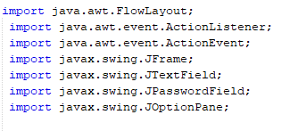
Todo : in the “TextFieldTest.java” file
Import the necessary libraries

Slide 5

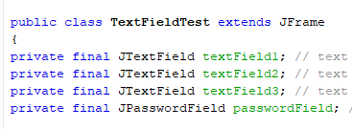
Todo : in the “TextFieldTest.java” file
Extend Jframe
Declare three textfields.

Slide 6
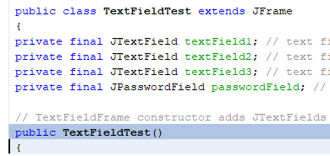
Todo : in the “TextFieldTest.java” file
Create a constructor

Slide 7
Todo : in the “TextFieldTest.java” file

Slide 8
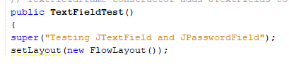
Todo : in the “TextFieldTest.java” file
Add “super” and Layout in the constructor.

Slide 9
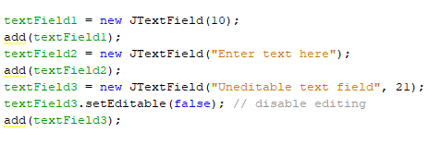
Todo : in the “TextFieldTest.java” file
Add the three declared text fields in the constructor.

Slide 10

Todo : in the “TextFieldTest.java” file
Add the password field in the constructor

Slide 11


Todo : in the “TextFieldTest.java” file
Create a text Handler object in the constructor
Add and ActionListener to the textFields and pass the handler.

Slide 12
Todo : in the “TextFieldTest.java” file
Add the following private class inside textFieldTest class.

Slide 13
Todo : in the “TextFieldTest.java” file

Slide 14
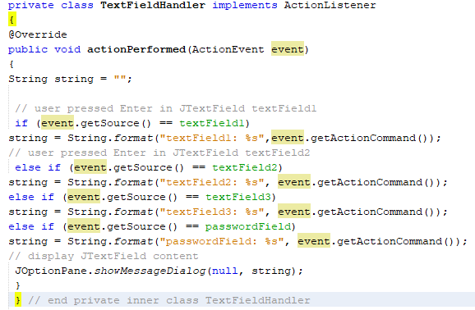

Slide 15

In the GuiExercise3.java main class
Import JFrame

Slide 16
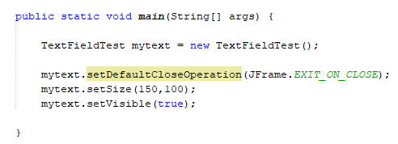
In the GuiExercise3.java main class

